Slide 1
Korszerű motorhajtóanyagok és kenőanyagok
2014. I. szemeszter
BME Kémiai és
Környezeti Folyamatmérnöki Tanszék
Mizsey-Tungler-Rácz
Notes:
Mit, miért, hogyan
Energiaszerkezet, a motorhajtóanyagok és kenőanyagok helye

Slide 2
Mit?
- közlekedési hajtóanyagok
- kenőanyagok

Slide 3
Közlekedési hajtóanyagok (fuels, kraftstoff, topliva)
Belső égésű motorok és sugárhajtóművek működtetésére szolgálnak, rendszerezésük
  Hagyományos kőolajalapú termékek (kőolajból összességében 50% feletti hozammal), fő csoportjai
    Motorbenzin (gasoline, petrol) a szikragyújtású Otto-, Wankel- stb. motorokhoz;
    Sugárhajtómű üzemanyag (kerosene, jet fuel) a sugárhajtású motorokhoz;
    Dízelgázolaj (gas oil) a Diesel- stb. motorokhoz
  Alternatív motorhajtóanyagok, fő csoportjai
    Földgáz (CNG, LNG);
    Propán-bután (LPG);
    Biohajtóanyagok (biomassza alapú etanol, ETBE, DME; NOME: RME stb.; szintetikus motorbenzin és gázolaj);
    Hidrogén (GH2, LH2), energiacella (fuel cell);
    Elektromos áram hálózatból (plug in);
    „Metanol gazdaság”
Tengerjáró hajók meghajtására: bunkerolaj (hagyományos kőolajalapú termék)

Slide 4
Coverage of transport modes and travel range by the main convential and alternative fuels
Fuel | Mode | Road-passenger |  |  | Road-freight |  |  | Air | Rail | Water
 | Range | short | medium | long | short | medium | long |  |  | inland | short-sea | maritime
Natural gas | LNG
(biomethane) | CNG
LPG
Gasoline
Gas oil
Kerosene
Bunker oil
Biofuels (liquid)
Hydrogen (fuel cell)
Electricity
Alternatives as classified by the EC Transport
  Based on European Commission COM(2013) 17 final (24.1.2013) ‘Clean power for transport: A European alternative fuels strategy’ p.4. Parliament vote is scheduled for Febr 2014 (http://hy-tec.eu/2013/10/regions-role-aknowleded-in-eu-parliament-report-on-clean-power-for-transport/). „The Council is expected to agree a draft text in the form of a general approach, with reduced ambitions compared to the Commission proposal, extending the deadline to 2030 and reducing the obligations for LNG. Nevertheless, this agreement could pave the way for an agreement between EP and Council before the European Parliament elections on 24-25 May 2014” <(http://europa.eu/rapid/press-release_MEMO-13-1095_en.htm)>.

Slide 5
Kenőanyagok (lubricants, Schmiermittel, smazki)
Egymáson elmozduló felületek közvetlen érintkezését gátló, súrlódás- és kopáscsökkentő anyagok, rendszerezésük az alkalmazott gépi berendezés szerint
  Motorolajok;
  Hajtóműolajok;
  Hidraulikaolajok;
  Kompresszorolajok stb.
  Kenőzsírok
Kenőolajok [alapolaj kőolajból ~ 1%-os hozammal + (szintetikus olaj) + adalék]: folyékony kenőanyagok, teljesítmény (API) és viszkozitás (SAE) szerinti osztályozással motor- és hajtóműolajoknál
Kenőzsírok [kenőolaj + gélképző Al, Ca, Li, Na stb. szappanok]: alaktartó, képlékeny anyagok, konzisztencia (NLGI) szerinti osztályozással
Notes:
API – Amer. Petr. Inst.
SAE – Society of Automotive Engineers
NLGI – National Lubricating Grease Institute (in the U.S.)

Slide 6
Közlekedési hajtóanyagok felhasználói (powertrains, Craftfahrzeug, transmissiya)
Belső égésű motorok (ICE, Verbrennungsmotor, dvigatel vnutrennovo sgoraniya): dugattyús hőerőgépek, bennük a motorhajtóanyag szabályozott égés során felszabaduló termokémiai energiája - a gázok hőmérséklet- és nyomáseséssel járó expanziója útján – mechanikai, mozgási energiává alakul. Főbb típusai
  Szikragyújtású Otto-motorok: a motorhajtóanyag és a komprimált levegő keverékének égését vezérelt idejű gyújtás indítja meg;
  Kompresszió-gyújtású Diesel-motorok: az égéstérbe befújt, vagy befecskendezett motorhajtóanyag a kompresszió következtében felmelegedett levegőtöltettől gyullad be (öngyulladás)
Sugárhajtóművek: sugárhajtás elvén működő járműhajtómű, hőerőgép és fúvóka együttesei, a tolóerő a belépő levegősugár és a kilépő égéstermék-sugár reakcióerőinek különbsége
Hajókazánok: hőerőgépek (gőzturbinák) túlhevített vízgőz hőenergiájának mechanikus energiává alakítására
Energiacella: anód + elektrolit + katód: a hajtóanyag kémiai energiáját villamos energiává alakítja. Motor
Akkumulátorok: villamos energia tárolására. Motor

Slide 7
A motorhajtóanyagok típusát és minőségét befolyásoló tényezők
motor-
konstrukciók
biztonság-
technika
környezetvédelem
energiapolitika
(világ)
humánbiológia
energiaforrás
rendelkezésre
állása
utóátalakító
katalizátorok
motorhajtóanyagok
részecskeszűrők,
-égetők
„üzleti fogások”
gazdaságosság
adalékok
kenőanyagok
hagyományok
Forrás: Hancsók Jenő: Ökológia, Regionalitás, Vidékfejlesztés Nemzetközi Nyári Egyetem és Workshop, Százhalombatta, 2008.08.11-14.
Notes:
WWFCh4

Slide 8
A gépjárműgyártás változásait és tendenciáit befolyásoló tényezők
KÉSZLETEK
FELHASZNÁLÁSA
KÖRNYEZETVÉDELEM
FOGYASZTÓI IGÉNYEK KIELÉGÍTÉSE
Hajtóanyag-takarékosság
Káros kibocsátások
Újrafelhasználhatóság
Megbízhatóság
Komfort
Kevesebb karbantartás
Általános hajtóanyag-minőség
Kormányzati intézkedések
Kis költségek
Motortechnológia
Hajtóanyag-technológia
Tribológia
Motorolaj-technológia
UTÓÁTALAKÍTÓ KATALIZÁTOROK

Slide 9
Miért?
- folyamatos kihívásokkal (éghajlatváltozás, importfüggőség, foglalkoztatás stb.) küzdő terület
- a világ legnagyobb (tőkeerős) cégei művelik
- a kőolaj-feldolgozás és a járműgyártás kimagasló jövedelmet adó ágazatok Magyarországon

Slide 10
World energy consumption in CMO (cubic mile of oil) per year
Today: 3 CMOpa; 50 yrs later: 6 CMOpa
Today wind&solar: 0.01 CMOpa. 1 CMO ~ 26 billion barrels of crude oil
Source: Carlson C.R. – Malhotra R.: www.forbes.com (9 Aug 2010)
Crude oil consumption in 2009: ~30 billion barrels
[1 CMO = 1.6x1.6X1.6 Ckm = 4.1 Ckm; 1 barrel = 159 l]

Slide 11
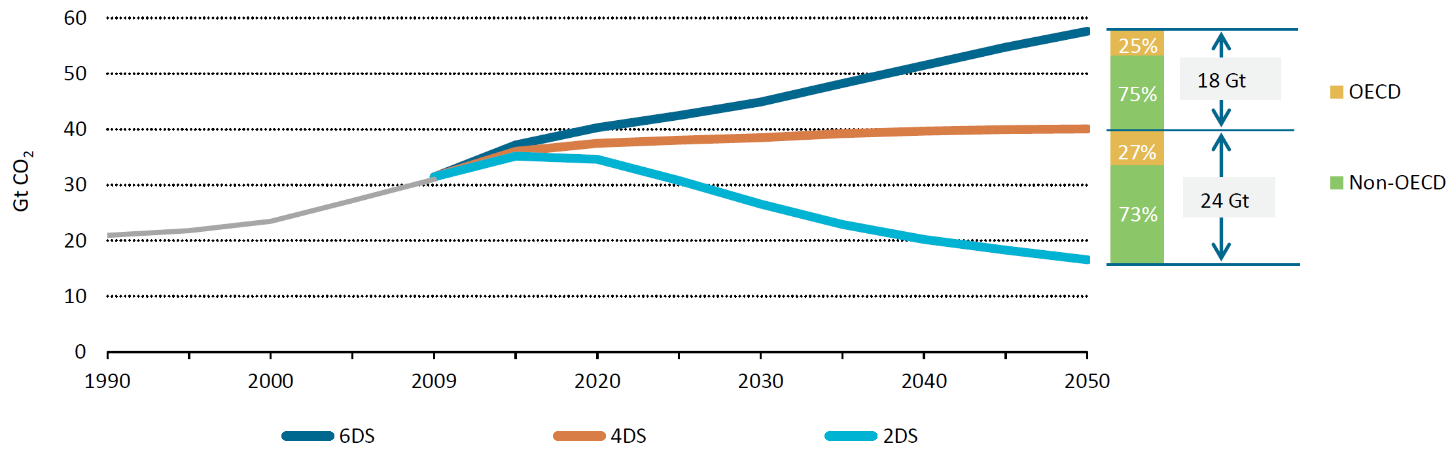
Choosing the future energy system
IEA
ETP
2012
To achieve the 2DS (limiting the long-term increase of the global mean temperature to 2°C: the pathway to sustainability), energy-related C0₂ emissions must be halved until 2050.
ETP – Energy Technology Perspectives. http://www.iea.org/etp/
Notes:
The message is clear: different energy systems deliver very different futures.
Governments have the responsibility to choose what future they want and start building the appropriate energy system now if that future is to be realised.
On a global basis, total primary energy supply (TPES) will grow in all scenarios.
In the 2DS, TPES increases by some 35% in the period 2009 to 2050.
This is significantly lower than the 85% rise seen in the 6DS and the 65% increase in the 4DS.

Slide 12
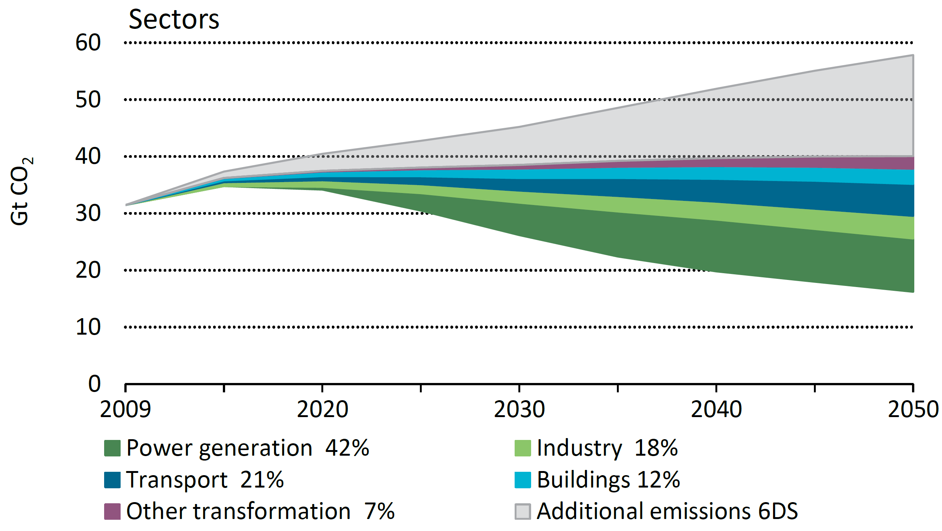
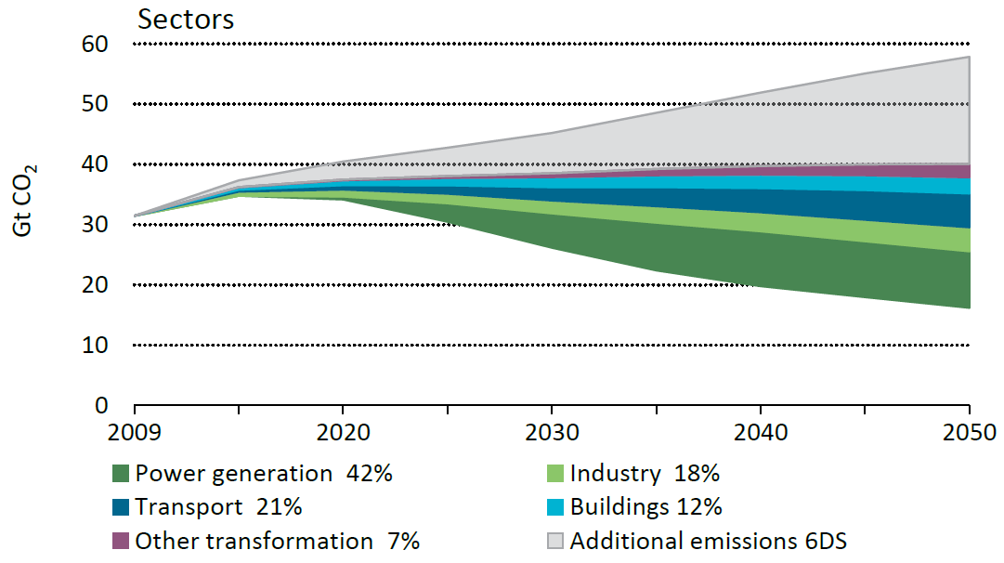
All sectors need to contribute
IEA
ETP
2012
The core of a clean energy system is low-carbon electricity that diffuses into all end-use sectors.
http://www.iea.org/etp/
Notes:
Achieving the 2DS requires a collective effort of all sectors at varying degrees:
The largest contributor, 42%, is the power generation sector, which is the backbone of a clean energy system as laid out in the 2DS.
Clean electricity is an important fuel for all end-use sectors and has thus implications on the whole economy.

Slide 13
Transport 2020 targets to reach 2DS
IEA
ETP
2012
Implement fuel economy standards through at least 2020 for LDVs and trucks in all major economies
Reach 5% of the fuel mix using biofuels, transitioning to advanced biofuels ASAP
Double the bus rapid transit global network
Increase by 50% the high speed rail network
Internalise the external cost (congestion, air pollution, etc.) of transport into fuel cost
Develop international tools to incentivise international shipping and aviation decarbonisation
Pursue RD&D efforts to further develop fuel cell vehicles
http://www.iea.org/etp/

Slide 14
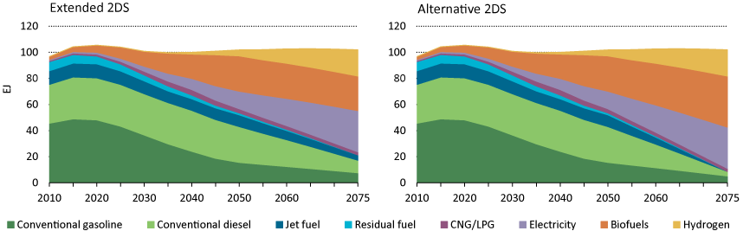
The extended 2DS – transport
IEA
ETP
2012
In Extended 2DS, global transport energy use remains fairly flat after 2050 as activity growth slows and efficiency improvements continue.
http://www.iea.org/etp/
Notes:
New technology vehicles continue to gain market share; hydrogen, biofuels and electricity account for three-fourths of energy use in 2075 in the extended 2DS, and almost 90% in the alternative 2DS.
Biofuels are held constant after 2050 in Extended 2DS but grow by 50% in the Alternative 2DS. All are advanced, near zero net CO₂.

Slide 15
Emission factors of different transport fuels
Fuels | kg CO2 / GJ | GJ / l | GJ / t
Natural gas | 56.06 (100) | 0.035 GJ/st.m3 | 0.035 GJ/st.m3
LPG | 63.20 (113) | 0.0249 | 45.9779
Aviation gasoline | 69.11 (123) | 0.0343 | 44.5900
Gasoline | 69.25 (124) | 0.0344 | 43.5674
Jet fuel | 70.72 (126) | … | 44.5900
Diesel fuel | 74.01 (132) | 0.0371 | 44.1667
Residual (bunker) oil (#6) | 77.3 (138) | 0.0405 | 40.7586
Relative emission factors (compared to natural gas’s)
GJ is based on lower heating values.
Source: viewed 10 Feb, 2014, www.ghgprotocol.org/files/ghgp/tools/co2-mobile.pdf.

Slide 16
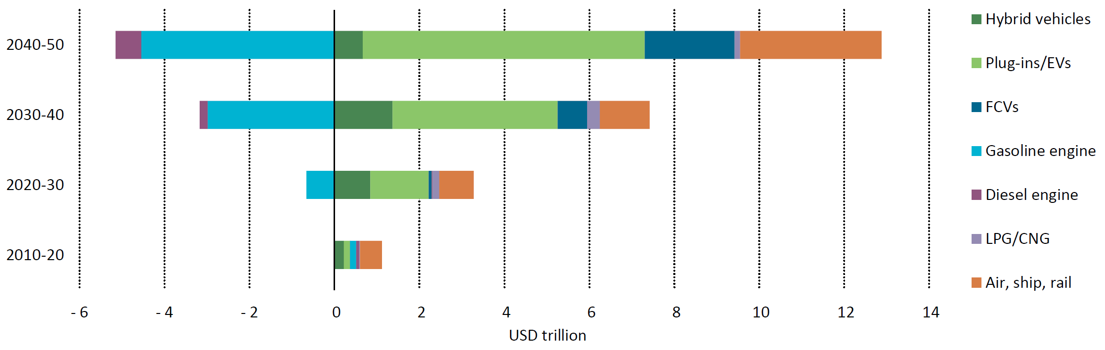
Transport : Additional investments
IEA
ETP 2012
.
The cost of decarbonising the transport sector accelerates after 2030 as greater investments are made in advanced vehicles and low-carbon options in air, shipping and rail. USD trillion = 10 12 USD
http://www.iea.org/etp/
Notes:
Under the 2DS, investments in conventional gasoline and diesel vehicles will be diverted to low-carbon advanced vehicles.
Over the next two decades, additional investments in low-carbon transport remain relatively low as significant cost reductions are needed before these vehicles break into the mass market.
After 2030, sharp declines in battery costs and fuel-cell vehicles occur in the 2DS, with investments in advanced vehicles surpassing conventional vehicles.
China accounts for the largest share of transport investments (based on full vehicle costs) in both scenarios – USD 60 trillion in the 6DS and USD 65 trillion in the 2DS – roughly 24% of total investments in global transport in each. This level of investment is slightly larger then in the United States and Europe.

Slide 17
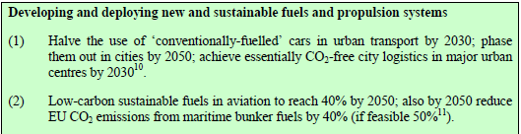
Ten goals for a competitive, resourse efficient transport system for 60% GHG emissions reduction target (1/3)
Source: White paper. Roadmap to a single European transport area. European Commission, Brussels, 28.3.2011. COM(2011) 144 final

Slide 18
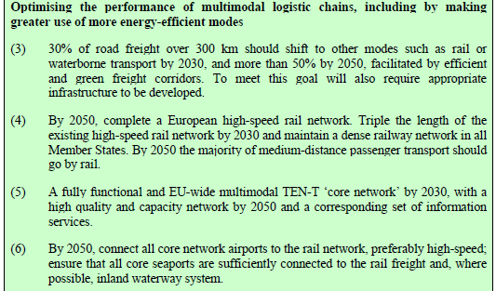
Ten goals for a competitive, resourse efficient transport system for 60% GHG emissions reduction target (2/3)
Source: White paper. Roadmap to a single European transport area. European Commission, Brussels, 28.3.2011. COM(2011) 144 final

Slide 19
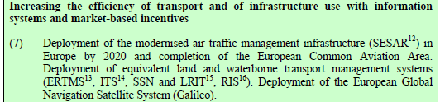
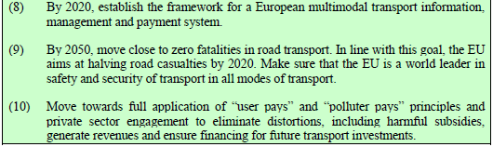
Ten goals for a competitive, resourse efficient transport system for 60% GHG emissions reduction target (3/3)
Source: White paper. Roadmap to a single European transport area. European Commission, Brussels, 28.3.2011. COM(2011) 144 final

Slide 20
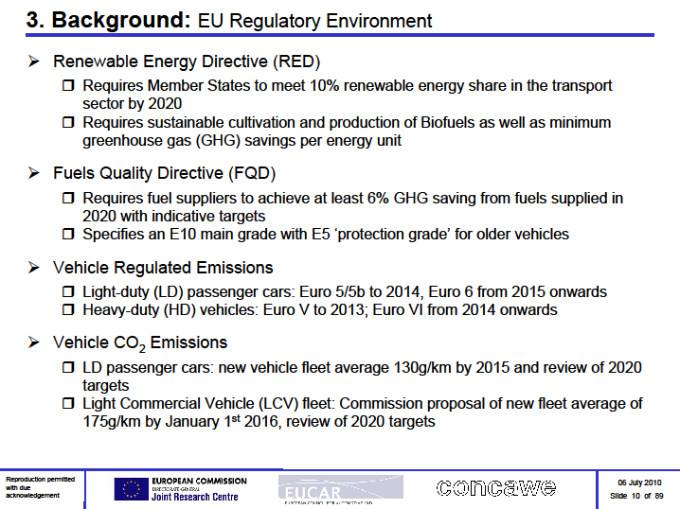
Overhauled energy taxation rules of 2011 (would be valid from 2018)
EU alternative fuels strategy of 2013 (and Directive on the deployment of alternative fuels infrastructure 2013)

Slide 21
EU Climate and Energy Package (20-20-20)
20% cut of GHG emissions by 2020 compared to 1990 level
  In ETS increasing share of auctioning (20% in 2013 gradually increasing to 70% in 2020). But, power producers: 100% from 2013, excluding 10 MSs (HU etc start at 30% in 2013 gradually rising to 100% in 2020). Plus ‘solidarity mechanism’ for 14 countries (incl. HU): increased amounts of allowances allowed to auctioning
  Legally binding 120 g CO2/km (130 through vehicle technology and 10 standards through air cond, tyres etc) of new passenger cars from 2012 (65% of the car fleet by 2012, 75% by 2013, 80% by 2014 and 100% by 2015). Plan for 2020: 95 g/km. Non-compliers will be penalised (Eur 5, 15, 25, 95 per excess gram) (Reg. EC No. 443/2009)
  Promotion and funding of 12 demonstration CCS plants
20% energy efficiency improvement by 2020 compared to the forecast (i.e. -1,5%/yr) – through action plan (2007-12)
20% renewable share by 2020 in overall energy consumption [RED-2009/28/EC]
  10% biofuels in transportation fuels by 2020
  Fuel suppliers have to decrease by 6% GHG (CO2, CH4, N2O) emissions over the entire life-cycle of their products (addition of biofuels, decreasing CO2 from refining). An additional 4% may be required from fuel co.-s (via supplying energy for electric vehicles, or other clean technologies, incl. CDM) [FQD-2009/30/EC]
  _______________________________________________________________________________
  European Commission proposal for 2030 (European Council decision expected in June 2014, draft law by early 2015) (40-..-27):
  40% cut of GHG emissions compared to 1990 level (would be -32% w/t intervention)
  Continued improvements in energy efficiency (to be reviewed in July 2014)
  27% renewable share in overall EU energy consumption (binding only for the bloc).
  Yearly average investments required b/n 2020&2030 amount for Euro billion 38.
  Based on: viewed 23 Jan 2014, <http://ec.europa.eu/clima/policies/2030/index_en.htm>.
Adopted by the EU Council on 6 Apr 2009

Slide 22
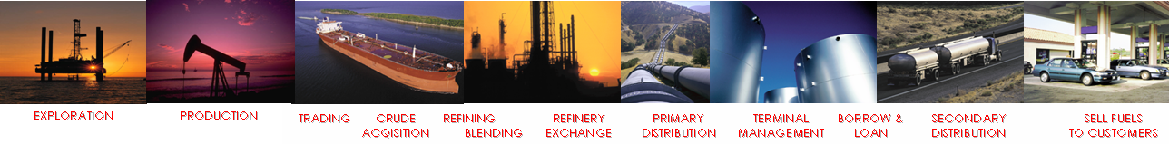

Talking points “CO2 in EU Transport”
Well-to-wheel analysis should form the basis for for policy developments
GHG life-cycle emissions per unit of energy
Production in Europe covered by ETS
Combustion of
unit of energy
85%
Crude Production
1 – 4 %
Refining
8 – 10 %
Distribution & retail
1%
WELL TO TANK ~15% (production)
TANK TO WHEEL ~85%
(consumption)
WELL TO WHEEL
Source: CONCAWE

Slide 23
CO2 emissions limits for vans
Amendment of reg 443/2009 as of 31 March 2011
Legally binding 175 g CO2/km of light vans up to 3.5 tons (2014: 70% of the fleet, 2015: 75%, 2016: 80%, 2017 : 100%)
Penalty from 2014 for non-compliance: max of Euro 95 per car for exceeding the target
By 2014, Commission may propose to extend to minibuses and vans up to 12 tons
Source: Council of the European Union, Brussels, 31 March 2011, 8406/11, PRESSE 86

Slide 24
Pending proposals to ‘overhaul’ energy taxation
Now: VAT + min. excise taxes on m3 of fuels (from 2010 for unleaded petrol: 359, gasoil: 330, kerosine: 330, LPG: 125, NG: 2.6)
From 2013 in support of sustainable growth: VAT + min. taxes with 2 elements
  Based on CO2 emissions: Euro 20 per tonne of CO2 emissions
  Based on energy content: Euro 9.6/GJ for transport fuels (petrol: 334, gasoil: 371); Euro 0.15/GJ for heating fuels (incl. coal)
  Expected to enter into force as of 2013 with long transitional periods until 2023
Minima proposed to be reached by 2018: petrol: 360, gas oil: 390, kerosene: 392, LPG: 500, NG: 10.7
Also significant minimum tax raises for heating fuels (gas oil, kerosene, fuel oil, LPG, NG, coal and coke) and modest raise for electricity
Impacts on motor fuels: due to the ‘neutral taxes’ increase in diesel or a reduction in gasoline rates, biofuels would be exempt from the CO2 element
Nine new MSs (incl. HU, SK) would not have to implement the CO2 element until 2020
Sources: http://europa.eu/rapid/pressReleasesAction.do?reference=MEMO/11/238&format=HTML&aged=0&language=EN&guiLanguage=en 13 Apr 2011
http://ec.europa.eu/taxation_customs/taxation/excise_duties/energy_products/legislation/index_en.htm 2 Feb 2013
http://ec.europa.eu/taxation_customs/taxation/excise_duties/energy_products/legislation/index_en.htm 12 Feb 2014

Slide 25
EU alternative fuels strategy for 2020, issued in 2013
‘Clean power for transport’: ‘gradually replace oil with alternative fuels and build up the necessary infrastructure ‘ savings on the oil import bill, additional jobs, lower CO2 emissions
Covers selected fuels and all modes of transport:
  LPG: road-passenger, road-freight, water (inland and short-sea)
  [in 2011 accounts for 3% of motor fuels, core infrastructure is already established; no new action is foreseen]
  LNG: road-passenger, road-freight, rail, water (inland, short-sea, maritime) [in 2011, 83 ports, and 38 road filling stations; port refuelling stations to be installed in all the EU 139 maritime and inland ports by 2020 and resp. 2025 + fixed or mobile truck refuelling stations are to be installed every 400 km along the roads of the TECN – trans European core network]
  CNG: road-passenger, road-freight (excl. long range) [in 2011 0.5% of the car fleet used it; ten-fold inrease by 2020, EU-wide refuelling points, with common standards with max distances of 150 km by 2020]
  Electricity: short-range road (passenger and freight), rail [today varying situation in the EU; significant (in HU thousand-fold) increase of recharging points using a common plug is required by 2020]
  Biofuels (liquid): road-passenger, road-freight, air, rail, water [already nearly 5% of the fuel market; their sustainability shall be ensured (10% is expected by 2020 according the 2009/28/EC directive)]
  Hydrogen (in fuel cells): road-passenger, road-freight, rail, water (inland) [today varying situation in the EU and around 120 filling stations in place] to form a network with common standards for 14 EU states which currently have a hydrogen network
Source: http://eur-lex.europa.eu/LexUriServ/LexUriServ.do?uri=COM:2013:0017:FIN:EN:PDF 2 Feb 2013

Slide 26
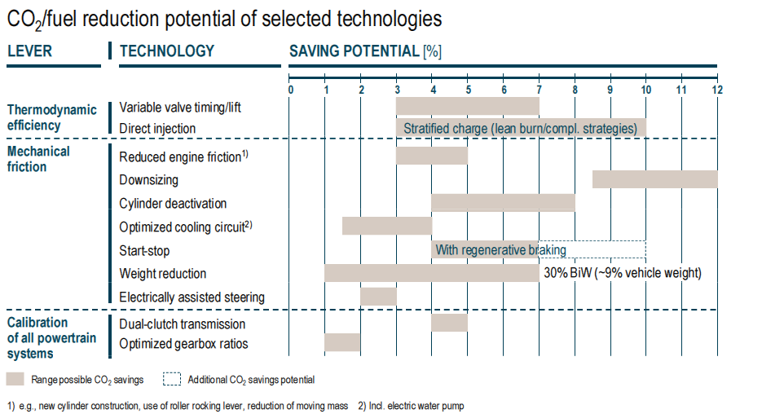

For Light Duty Vehicles an evolutionary roadmap may deliver substantial CO2 improvements by a variety of technologies…..
BiW: Body in White (gépjármű karosszéria)

Slide 27
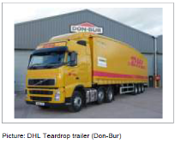
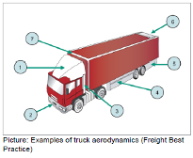
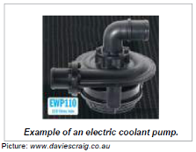
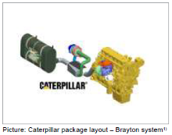
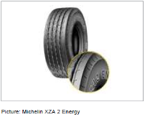
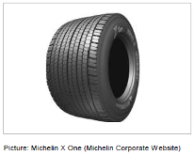
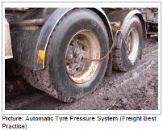
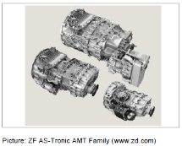
……as well as for Heavy Duty Vehicles in addressing rolling resistance, aerodynamic drag and drive-train efficiency improvements.
Aerodynamic
trailers
Aerodynamic
fairings
Electric waterpumps
Waste heat recovery
10%
6,5%
4%
6%
Low rolling
Resistance tyres
Single wide tyres
Tyre pressure
adjustment
Automated
transmission
5%
10%
8%
10%
10%
= anticipated fuel savings.
Should not be added.
Source: Ricardo

Slide 28
Aviation: By 2020, technology improvements will reduce fuel consumption by 21 %; up to 50 % beyond 2020
Timelines and examples of technologies | Impact
Retrofits | 7-13%
Winglets mounted on the wingtips of aircraft improve aerodynamics and reduce fuel burn More advanced engine components for better combustion and airflow Lighter materials for furnishing in the cabin Less energy-consuming lighting and in-flight entertainment
Production Updates | 7-18%
More airframe structure components made of lightweight composite material instead of aluminium Advanced engines for current aircraft production series
New aircraft design before 2020 | 25-35%
Geared turbofan engine will reduce fuel burn 10-15% Open rotor engine will reduce fuel burn around 25% Counter-rotating fan will reduce fuel burn 10-15% Advanced turbofan will reduce fuel burn around 15% Laminar flow reduces aerodynamic drag by reducing turbulence on aircraft surface, 10-15% less fuel burn
New aircraft design after 2020 | 25-50%
Blended wing body, rather than the classical tube-and-wing architecture Revolutionary engine architectures Fuel cell system for on-board energy
Source: IATA

Slide 29
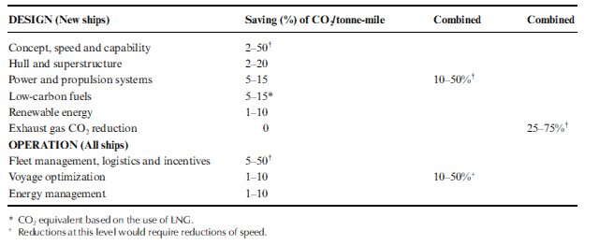
IMO: Technology and operation measures could reduce marine CO2 emissions from shipping by up to 60%.......
Natural gas when stored in a liquified stage as LNG could be an attractive fuel for a few categories of ships ( coastwise shipping )
It is questionable in a non-regulated world, whether biofuels would be applied due to poor economics, some operability issues and even more so by limited availability.
Source: IMO

Slide 30
A világ legnagyobb olaj- és gázcégei és autógyártói Upper decile from Fortune Global 500 (July 23, 2013)
For fiscal yr ended Jan 31 2013
No | Cég | Bevétel | Profit
1. | R.D. Shell | 481,7 | 26,6
3. | ExxonMob | 449,9 | 44,9
4. | Sinopec | 428,2 | 8,2
5. | ChinaNatP | 408,6 | 18,2
6. | BP | 388,3 | 11,6
10. | Total | 343,3 | 13,7
11. | Chevron | 233,9 | 26,2
16. | Phillips 66 | 169,6 | 4,1
17. | ENI | 167,9 | 10,0
21. | Gazprom | 153,5 | 38,1
25. | Petrobras | 144,1 | 11,0 2,1
36. | Pemex | 125,2 | 0,2
38. | PDVSA | 124,5 | 2,7
39. | Statoil | 124,4 | 11,8
46. | Lukoil | 116,3 | 11,0
Global 500 | Cég | Bevétel, MrdUSD | Profit, MrdUSD
8. | Toyota Mot. | 265,7 | 11,6
9. | Volkswagen | 247,6 | 27,9
22. | GM | 152,3 | 6,2
23. | Daimler | 146,9 | 7,8
28. | Ford Motor | 134,3 | 5,7 4,4
47. | Nissan Mot. | 116,0 | 4,1
45.
Honda M.
119,0
27.
Valero
138,3
- 6(7) O&G co.-s and 2(1) car manufacturer in the first 10
- 16(15) O&G co.-s and 7(6) car manufacturers in the first 50 (upper decile)
- OMV: 176. 54,8/1,8; PKN: 297. 36,9/0.7; MOL: 474. 24,7/0.7
Notes:
A világ legnagyobb forgalmú cégeinek felső decimilisében 11 helyet (>20%) olajtársaságok, 5 helyet (10%) autógyártók foglalnak el.
A Global 500 listán szereplő régiós olajtársaságok:
333. OMV 25 1
398. PKN Orlen 22 0,4
Az egy évvel korábbi listán szerepelt a MOL és a Neste is.

Slide 31
A világ legnagyobb olaj- és gázcégei és autógyártói Best companies from Forbes Global 2000 (Apr, 2013)
Assessed on sales, profits + assets & market value
No | Cég | Bevétel | Profit
5. | ExxonMob | 420,7 | 44,9
7. | R.D. Shell | 467,2 | 26,6
9. | PetroCina | 308,9 | 18,3
13. | Chevron | 222,6 | 26,2
17. | Gazprom | 144 | 40,6
18. | BP | 370,9 | 11,6
20. | Petrobras | 144,1 | 11
23. | Total | 240,5 | 14,1
26. | Sinopec | 411,7 | 10,1
30. | ENI | 163,7 | 10
38. | Statoil | 126,8 | 12,4
59. | Rosneft | 68,8 | 11,2
64. | Lukoil | 116,3 | 11
40. | Statoil | 119,6 | 14,1
49. | Lukoil | 111,4 | 10,4
Global 500 | Cég | Bevétel, MrdUSD | Profit, MrdUSD
14. | Volkswagen | 254 | 28,6
31. | Toyota Mot. | 224,5 | 3,4
36. | Daimler | 150,8 | 8
53. | Ford Motor | 134,8 | 5,7
55. | BMW Group | 98,8 | 6,6
70. | GM | 152,3 | 6,2
- 14 O&G co.-s and 8 car manufacturers in the first 100 (upper 5%)
- 7 O&G co.-s and 1 car manufacturer in the first 20 (upper 1%)
- OMV: 304. 56,3/1,8; PKN: 651. 38,8/0.8; MOL: 660. 24,6/0.7; Neste: 1524. 23,7/0,2
Össz. 2000 38 billió 2,43 bill.
Notes:
A világ legnagyobb forgalmú cégeinek felső decimilisében 11 helyet (>20%) olajtársaságok, 5 helyet (10%) autógyártók foglalnak el.
A Global 500 listán szereplő régiós olajtársaságok:
333. OMV 25 1
398. PKN Orlen 22 0,4
Az egy évvel korábbi listán szerepelt a MOL és a Neste is.

Slide 32
Rendszeres havi bruttó átlagkeresetek néhány ágazatban, 2013. I-IX., vagy I-XI. hónapok, eFt
Ágazat | Fizikai fogl. | Szellemi fogl.
Kokszgyártás, kőolaj-feld. I-IX. Járműgyártás I-IX. | 333,7 206,7 | 601,8 435,4
Vegyi anyag, termék gyártása I-IX. | 212,0 | 388,3
Gyógyszergyártás I-IX. | 271,3 | 433,8
Gumi-, műanyag, nem-fémes ásv. termékek gy. I-IX. Feldolgozóipar I-IX. | 175,9 170,3 | 342,3 363,5
Vill.en.-, gáz- és gőzelőáll., légkondicionálás I-XI. | 273,3 | 409,4
Ipar összesen I-XI. | 174,4 | 362,1
Pénzügyi, biztosítási tev. I-XI. | 191,8 | 408,1
Nemzetgazdaság összesen I-XI. | 153,1 | 282,5
A kokszgyártás és kőolaj-feldolgozás , vm. a járműgyártás kimagasló átlagkeresetet nyújtó ágazatok Magyarországon
Forrás: www.ksh.hu, 2014. febr. 8.
Hay 2012 guide: annual salaries for graduate in OI (process control): 33.8 kUSD pa ~ 645 kHuF / month

Slide 33
A motorhajtóanyagok és kenőanyagok helye - összefoglalás
A motorhajtóanyagok és kenőanyagok fő forrása ma és a közeljövőben a kőolaj. Az energiaszerkezetben ma domináns az olaj (34%) [az olaj peaking 2025 utánra tehető, a globális R/P arány >40]
A motorhajtóanyagok (benzin, középdesztillátumok) a kőolajból >50%-os hozammal gyárthatók. A kenőanyagok az egyéb termékekhez sorolhatóak, hozamuk ~1%, de nélkülözhetetlenek
A jövőben fokozódó elvárás a CO2 kibocsátás csökkentése az energiatakarékosság és az alternatív hajtóanyagok részarányának növelése útján (EU2020 a megújulókra: 20%, a bioüzemanyagokra 10%), 2050-ig jelentős változás (az olajtermékek részaránya felére csökkenhet a közlekedésben)
Termelői/felhasználói a világ legnagyobb cégei közé tartoznak, kimagasló keresetek az olajiparban és járműgyártásban

Slide 34
Hogyan?
- előadások
- beszámoló

Slide 35
Témakörök, találkozások
Energiaszerkezet, a motorhajtóanyagok és kenőanyagok helye
Belső égésű motorok és működésük
Kőolaj és földgáz keletkezése és osztályozása, tartalékok, oil peaking
Kőolaj és földgáz termelése, a kőolaj tulajdonságai
Kőolajfeldolgozás, motorhajtóanyag-gyártás
Alternatív motorhajtóanyagok
Kenőanyagok, kenés
Kipufogógáz kezelés
Hibridautó, energiacella
HW: W. Shakespeare: Lear király, 3. felvonás , 2. szín szövege szerint reális-e a Bolond jóslata a jövő közlekedéséről
Kis házi feladatok, találkozások a tanszéki könyvtárszobában 17:15-kor:
febr. 13, febr. 20, febr. 27, márc. 6, márc. 13, márc. 20, márc. 27, ápr. 3, ápr. 10, ápr. 17, ápr. 24, máj. 8, máj. 15.
Máj. 15. beszámoló
liracz@gmail.hu

